Slide 1


Time series analysis of aapl stock
Leon Zhu
UCLA Stats 418 – Tools in Data Science
Spring 2019
Department of Statistics

Slide 2
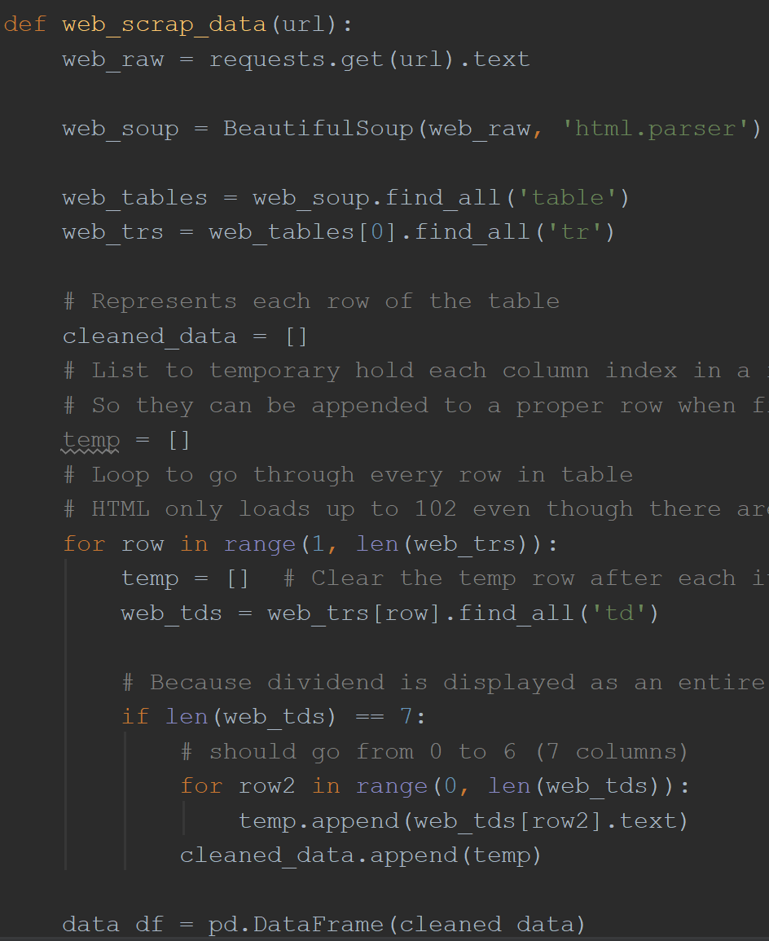
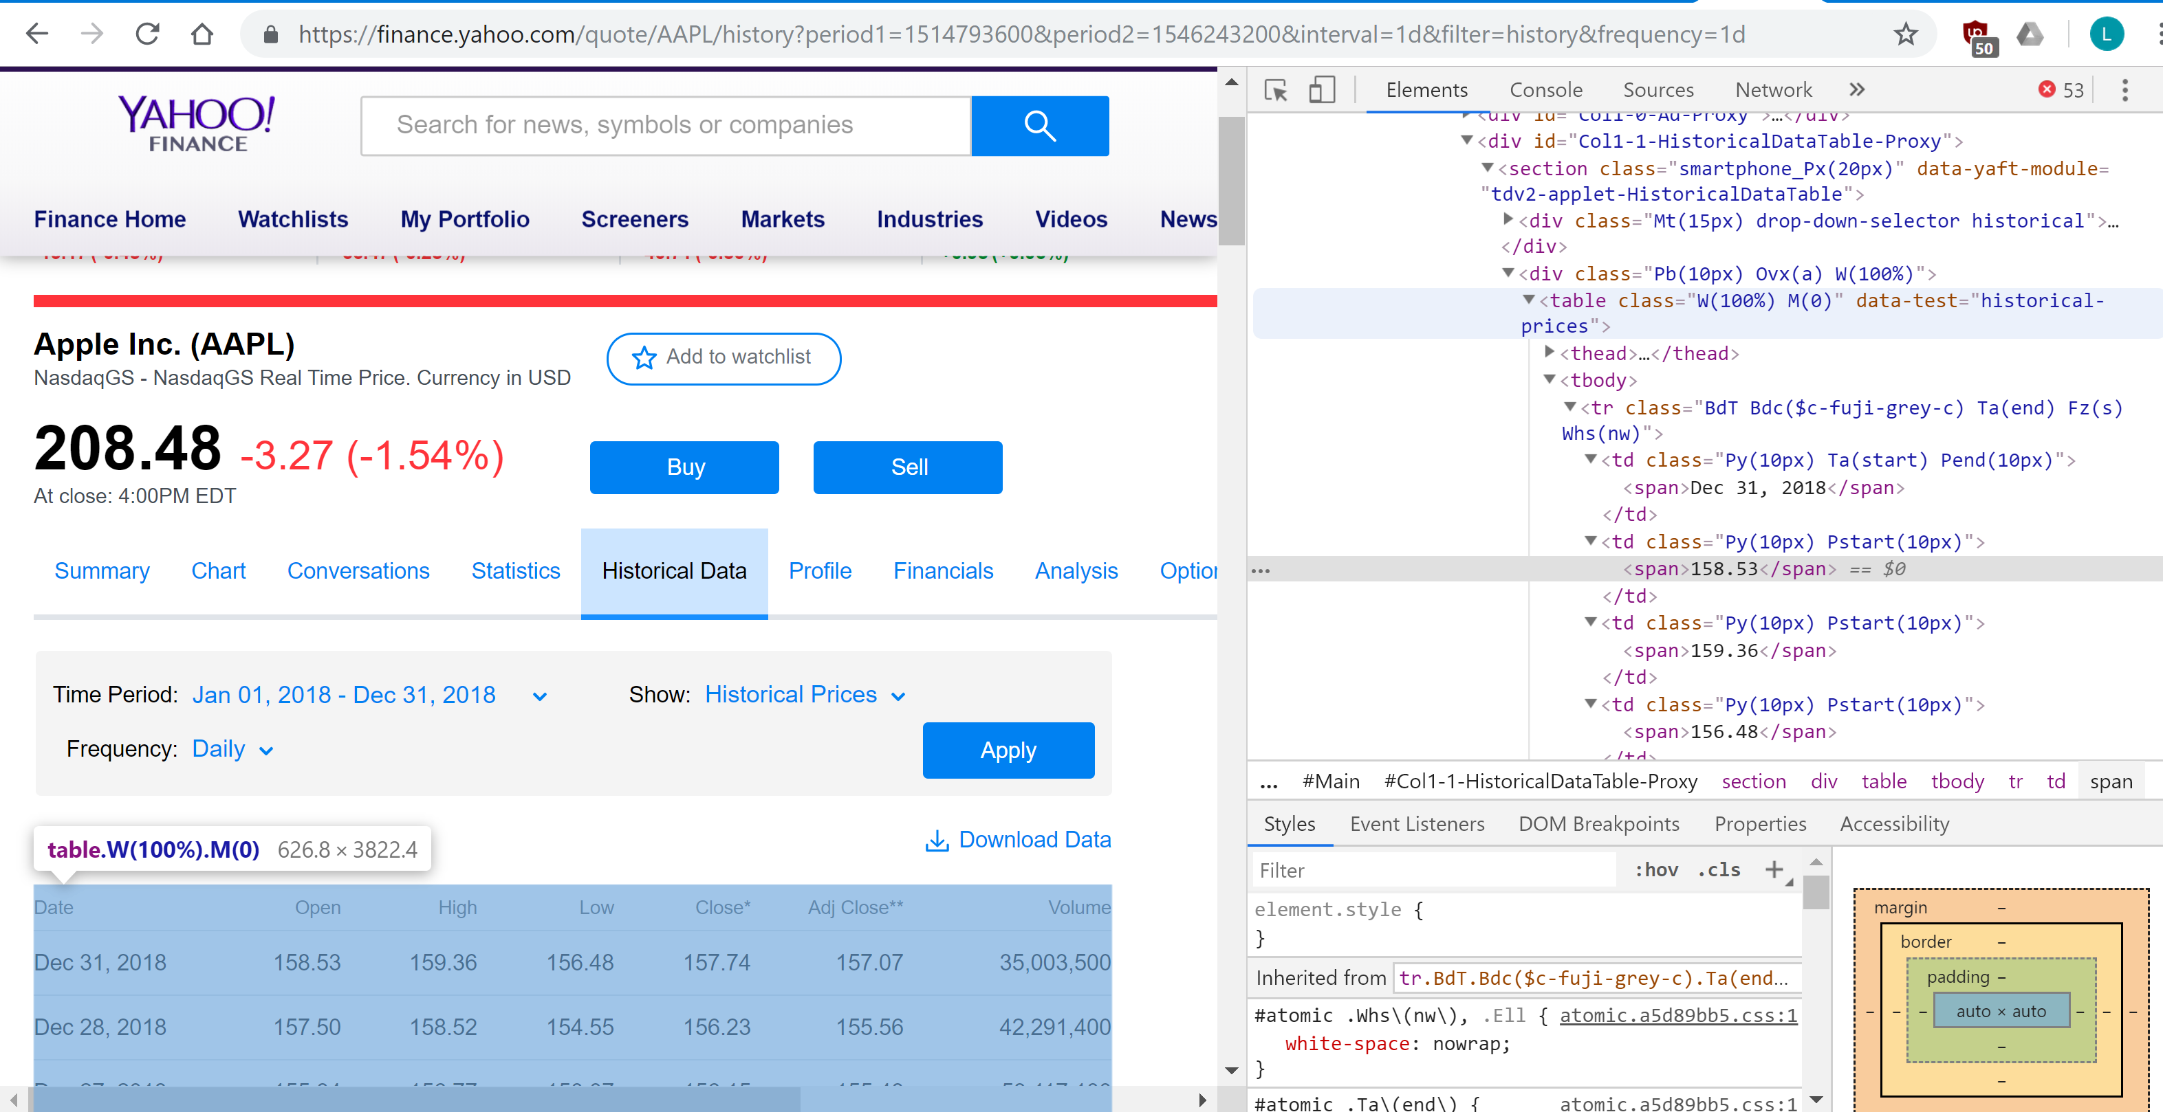
Attaining the dataset – Web Scrap

Slide 3
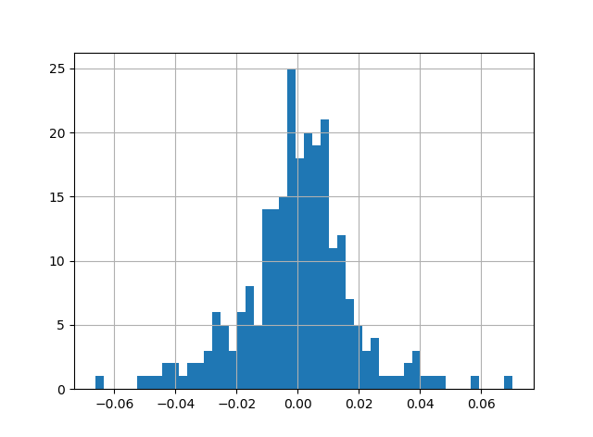
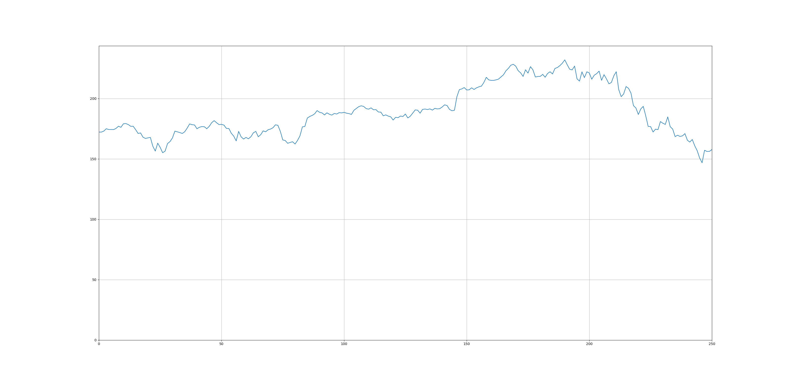
Exploratory Analysis
Histogram of the daily percent change

Slide 4
Proposal
Conduct Time series analysis on Apple stock price using the daily closing price
Product: Given input historical stock price data, produce a forecast of the short term price with a 95% confidence interval

